Slide 1
Large Language Models
for Software Engineers
Session 2: The Agent Loop, Tools, and Memory
Monarch Wadia · monarchwadia.com

Slide 2
SECTION 1
Logistics & Goals
From the Single Call to the Agent Loop
2 / 43

Slide 3
Where We Left Off: The Single Call
• Stateless Engine: The remote LLM retains zero state between requests (`f(messages) -> message`).
• History in Application RAM: The host application stores the message array and appends each turn.
• Control vs. Data Plane: The `system` prompt dictates persona, guardrails, and output schemas.
• The Next Step: Moving from manual single calls to automated multi-turn execution loops.
// Session 1: Stateless Single Call
var request = new ConverseRequest
{
ModelId = "anthropic.claude-3-5-sonnet",
System = new List<SystemContentBlock>
{
new() { Text = "You are a banking assistant." }
},
Messages = new List<Message>
{
new()
{
Role = ConversationRole.User,
Content = new() { new() { Text = "Ping" } }
}
},
InferenceConfig = new() { MaxTokens = 100 }
};
var response = await client.ConverseAsync(request);
Console.WriteLine(response.Output.Message.Content[0].Text);
3 / 43

Slide 4
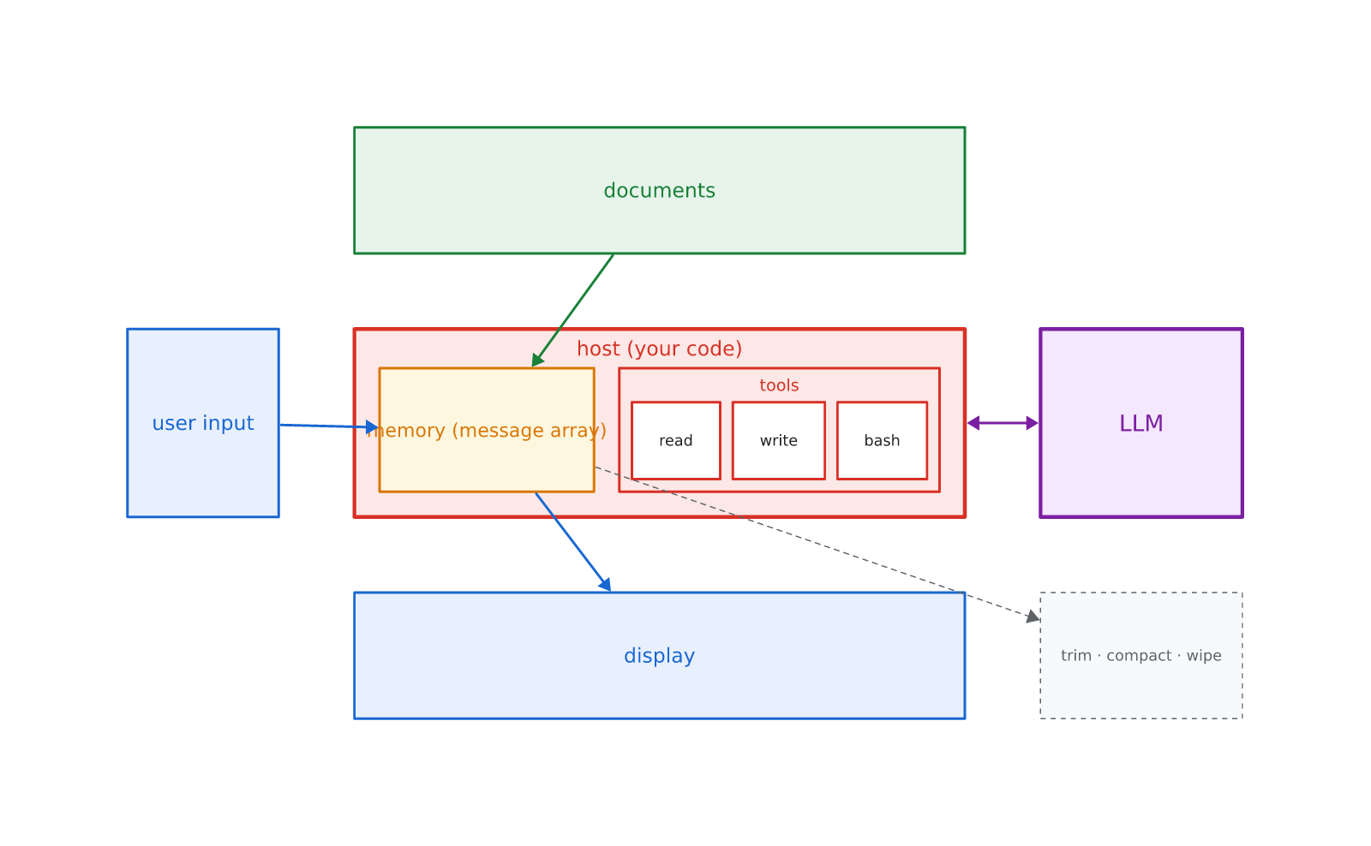
Workshop Series Learning Outcomes
• 1. Treat LLMs as Infrastructure: View models as stateless HTTP microservices with explicit schemas.
• 2. Build from First Principles: Connect the Model (generation), Harness (logic & RAM), and Tools (APIs).
• 3. Control Developer Agent Tools: Diagnose and optimize tools like Cursor, Claude Code, and Copilot.
• 4. Prevent Production Failures: Guard against context overflow, format drift, and hallucination.
4 / 43

Slide 5
Session 2 Learning Outcomes
• 1. Build the Agent Loop: Implement the 5-step loop (input, memory, call, append, display).
• 2. Put Knowledge in the Loop: Connect external documents via RAG and whole-file attachments.
• 3. Turn Output into Action: Upgrade from brittle text scraping to the structured tool contract.
• 4. Equip the Toolbox: Implement read tools, the surgical write idiom, and the shell.
• 5. Master Memory Management: Control context growth with trim, compact, and wipe operations.
5 / 43

Slide 6
SECTION 2
The Simplest Agent
The Loop, the Memory Array, and Content Blocks
6 / 43

Slide 7
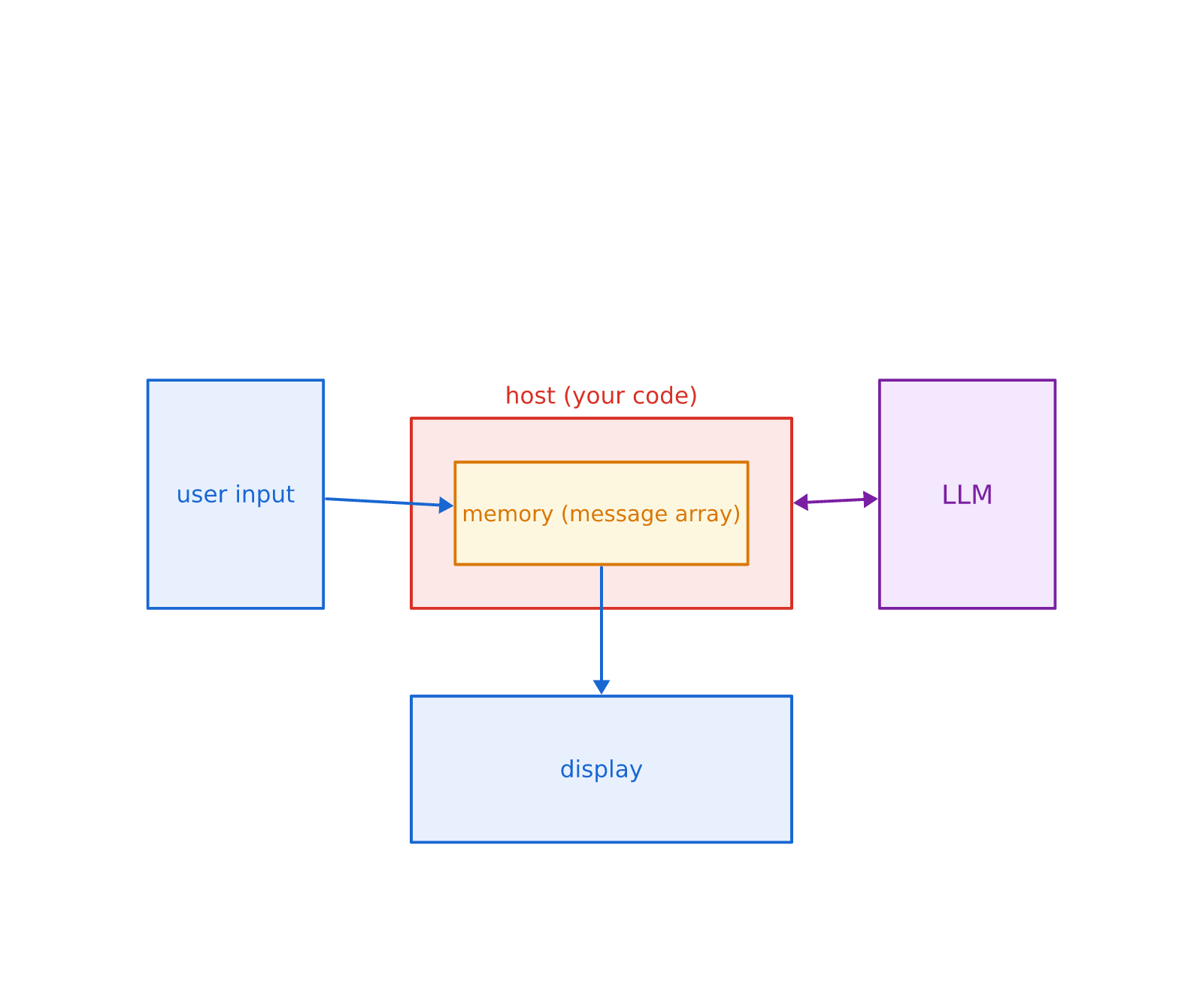
The Simplest Agent Loop
• The Five Steps: Capture user input, append to memory, call LLM, append response, display.
• The Host (Your Code): Your application is the driver; it owns the loop and the state.
• The Memory Array: A plain in-memory list of messages passed on every API call.
• The Remote Model: Meets the transcript fresh on every invocation; holds no internal memory.
7 / 43

Slide 8
The Loop in Code
• The Skeleton: The whole agent is one list, one HTTP call, and a while loop around them.
• Harness Drives State: The LLM never 'decides' to remember; your code mutates the array.
• Deterministic Host: Your host controls exit conditions, retry policies, and timeouts.
// The Full Agent Loop in C#
var memory = new List<Message>();
while (true)
{
Console.Write("> ");
var input = Console.ReadLine();
if (string.IsNullOrEmpty(input)) break;
// 1. Append user input
memory.Add(new Message {
Role = ConversationRole.User,
Content = new() { new() { Text = input } }
});
// 2. Call LLM with full transcript
var response = await client.ConverseAsync(
new ConverseRequest { Messages = memory }
);
// 3. Append response & display
var reply = response.Output.Message;
memory.Add(reply);
Console.WriteLine(reply.Content[0].Text);
}
8 / 43

Slide 9
The Array Is the Conversation
• The Array Is the Mind: The model keeps no diary and has zero memory of prior turns.
• Total Amnesia on New Chat: Starting a new chat simply initializes an empty array.
• The Rewind Effect: Editing an old message rewrites the array; future turns vanish instantly.
// The Conversation Transcript Array
[
{
"role": "user",
"content": "add rate limiting to login"
},
{
"role": "assistant",
"content": "I will start by checking the route."
},
{
"role": "user",
"content": "make it 5 attempts max"
},
{
"role": "assistant",
"content": "Updated lockout threshold to 5."
}
]
9 / 43

Slide 10
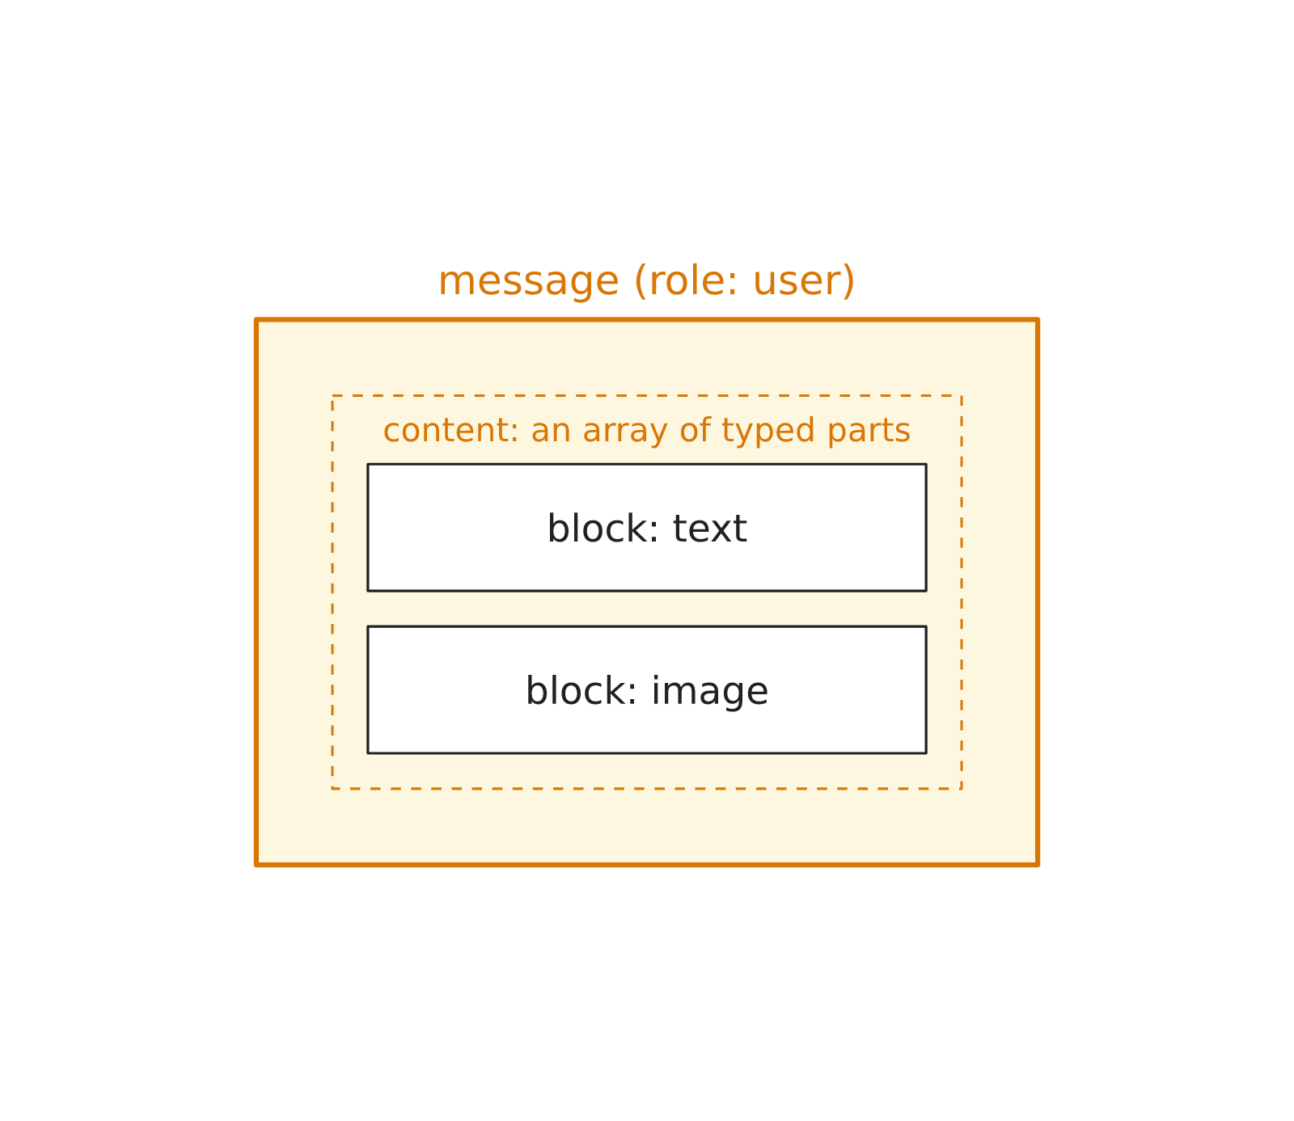
Everything Is a Content Block
• Message Anatomy: A message content is an array of typed blocks (text, image, tool_result).
• Multi-Modal Inputs: Screenshots and attachments ride in through the exact same door.
• Token Economics: Image blocks consume significant token budgets; send only what is needed.
• Unified Door: Tool outputs and error messages enter the memory array as content blocks.
10 / 43

Slide 11
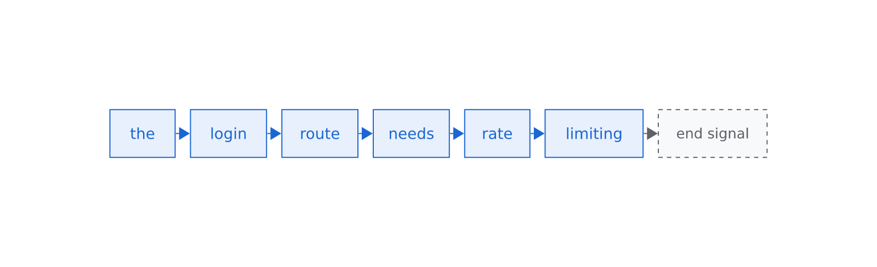
Streaming & Partial Information
• Real-Time Generation: Models emit tokens sequentially as they are generated over HTTP.
• Perceived Latency: Streaming provides immediate visual feedback during long generations.
• The Partial State Trap: A half-streamed response is an incomplete sentence or truncated JSON.
• The Golden Rule: Treat streamed output as unverified until the end-of-turn signal arrives.
11 / 43

Slide 12
The Flaw: The Loop Only Appends
• The Hidden Flaw: The basic loop only ever adds; nothing is ever removed automatically.
• Compounding Cost: The full array is re-sent on every turn, billing prior tokens repeatedly.
• Context Ceiling: Without active management, long conversations inevitably overflow the window.
// Turn 1: 150 tokens
messages = [ U1, A1 ]
// Turn 5: 1,800 tokens (resending everything!)
messages = [ U1, A1, U2, A2, U3, A3, U4, A4, U5, A5 ]
// Turn 20: 18,000 tokens (approaching budget ceiling)
messages = [ U1, A1, ... U20, A20 ]
// Flaw: Append-only growth
// Total Cost = Sum(Turn_i * Tokens_i)
// Without trimming, latency and costs explode.
12 / 43

Slide 13
SECTION 3
Knowledge in the Loop
RAG, Attachments, and Cracking the Sealed Loop
13 / 43

Slide 14
The Sealed Loop Problem
• Training Cutoff: The model knows only public training data up to its cutoff date.
• Private Data Gap: Internal policies, customer records, and codebases were never in the training set.
• Cracking the Seal: External knowledge must be actively injected into host memory by your code.
// Query to standard model without context:
{
"role": "user",
"content": "Can an annual subscriber get a refund after 2 months under our policy?"
}
// LLM Output (Unanchored Guess):
"Under standard SaaS industry practices, annual plans are non-refundable after 30 days..."
Hallucination / Knowledge Gap: The model invents plausible generic answers because company policies were never in its training set.
14 / 43

Slide 15
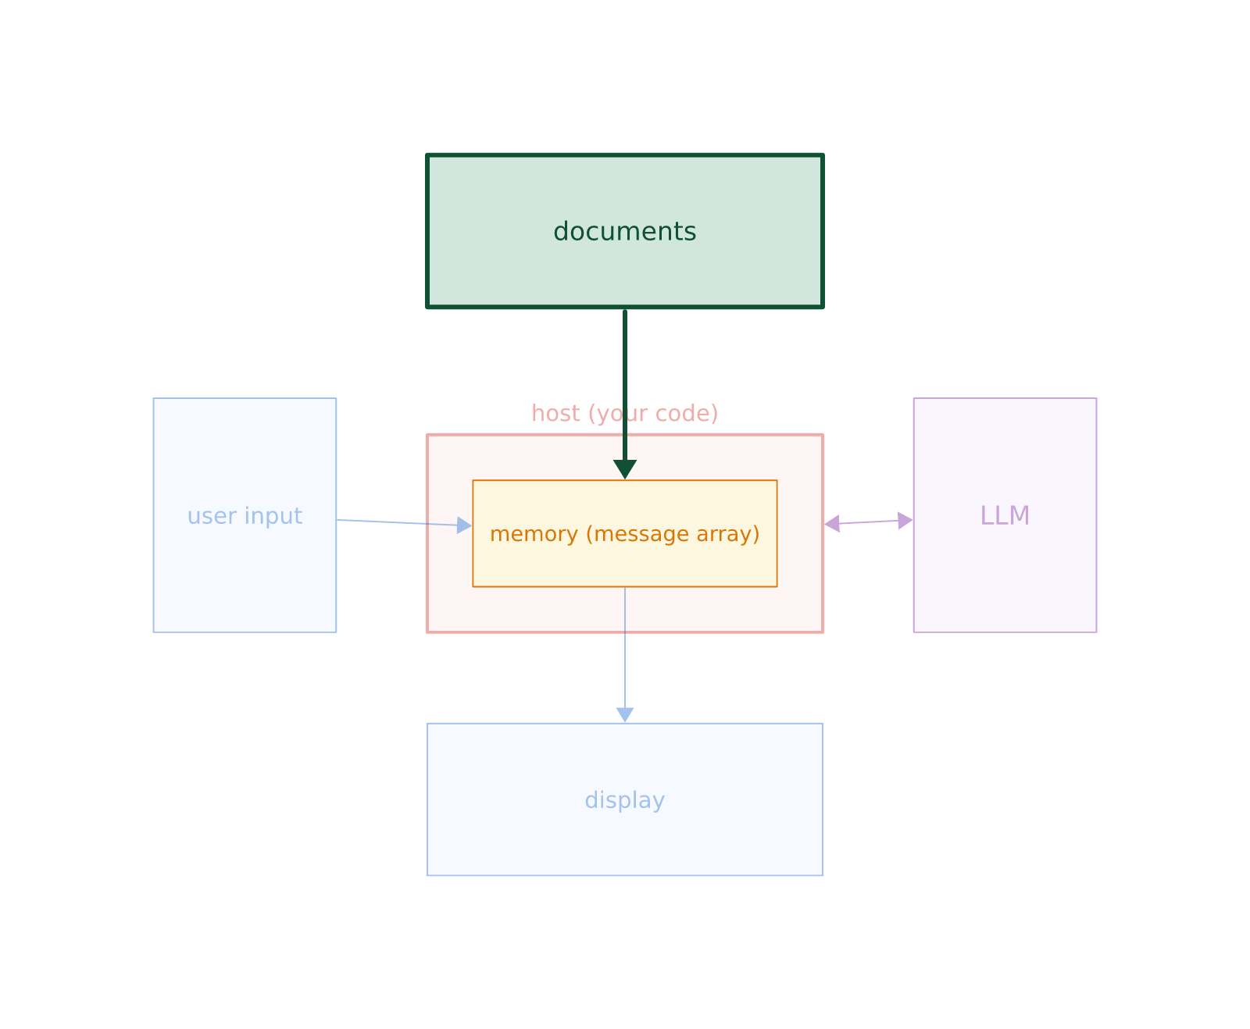
Knowledge on Demand: RAG
• Retrieval-Augmented Generation: The host searches documents and pastes excerpts into memory.
• Sliding the Page Across: We do not retrain the model; we hand it the relevant page to read.
• No Library Shelf in the LLM: The model reads the injected context just like standard prompt text.
15 / 43

Slide 16
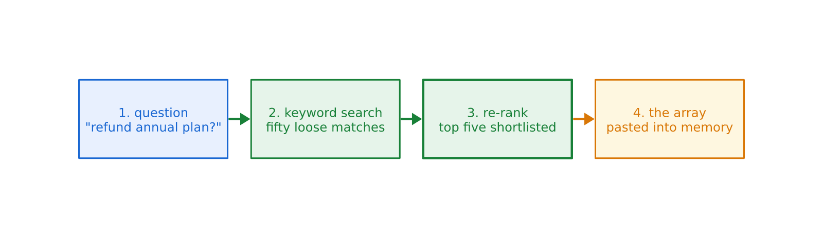
Retrieve Wide, Read Narrow
• Step 1: Broad Search: Keyword, vector, or hybrid search pulls candidate document excerpts.
• Step 2: Re-Ranking: Score candidate passages against the query to select the best 3 to 5.
• Search as an Upgraded Arrow: Whether keyword, vector, or graph search, the loop interface is identical.
16 / 43

Slide 17
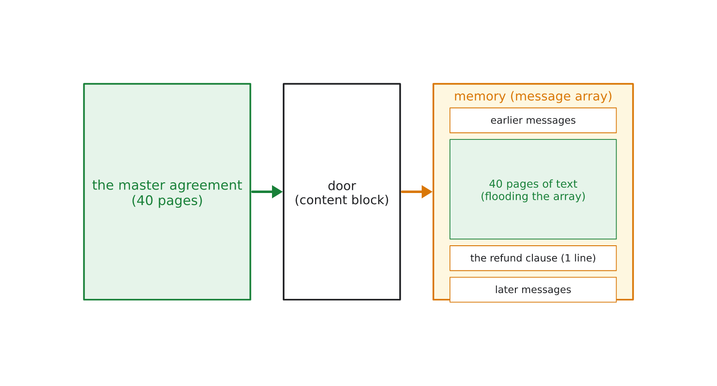
Include It Whole: Attachments
• Direct Attachment: For concise documents (1-3 pages), attach the entire text or PDF directly.
• Zero Search Latency: Eliminates indexing, vector databases, and retrieval misses.
• Non-Text Media: Scanned agreements, architecture diagrams, and charts ride in as image blocks.
17 / 43

Slide 18
Retrieval Traps: Trust & Flood
• The Trust Flaw: The model treats injected text as truth; stale policies yield confident stale answers.
• The Flood Flaw: Attaching massive binders dilutes attention and inflates latency and token cost.
• Best Practice: Curate document sources and inject only the precise excerpts required.
// Attaching a 50-page Master Agreement:
messages = [
{
"role": "user",
"content": [
{ "type": "text", "text": "Find refund terms:" },
{ "type": "text", "text": "[... 45,000 words of legal definitions ...] Section 14.2: Refunds permitted within 90 days pro-rata." }
]
}
]
The Needle Drowned: 45,000 words of boilerplate dilutes model attention and bills full token costs on every subsequent turn.
18 / 43

Slide 19
SECTION 4
The First Way to Act
From JSON Output to the Tool Contract
19 / 43

Slide 20
The Homemade Actor
• The Naive Approach: Prompting the model to emit ad-hoc JSON action commands in text.
• Host Acts as Scraper: The host inspects the text, parses JSON, executes, and replies.
• Brittle Integration: Mixing natural language reasoning with execution commands in one string.
// System Prompt:
If you need to run tests, output raw JSON:
{"action": "run_test", "path": "test_auth.py"}
// Host Code:
var reply = response.Output.Message.Content[0].Text;
if (reply.Contains(""action": "run_test""))
{
var json = ExtractJson(reply);
RunTest(json.Path);
}
20 / 43

Slide 21
When the Seams Show
• Conversational Leakage: Models naturally prepend explanations ('Sure, I can help...').
• Markdown Fences: Delimiters like ```json break strict JSON parsers.
• The Seam Problem: String parsing against generative text is brittle in production.
// Actual Model Output:
Sure! I would be happy to run those tests for you.
Here is the command:
```json
{
"action": "run_test",
"path": "tests/auth/test_login.py"
}
```
Let me know if you need anything else!
Format Drift & Parsing Failure: Markdown code fences and conversational wrapper text broke System.Text.Json parser.
21 / 43

Slide 22
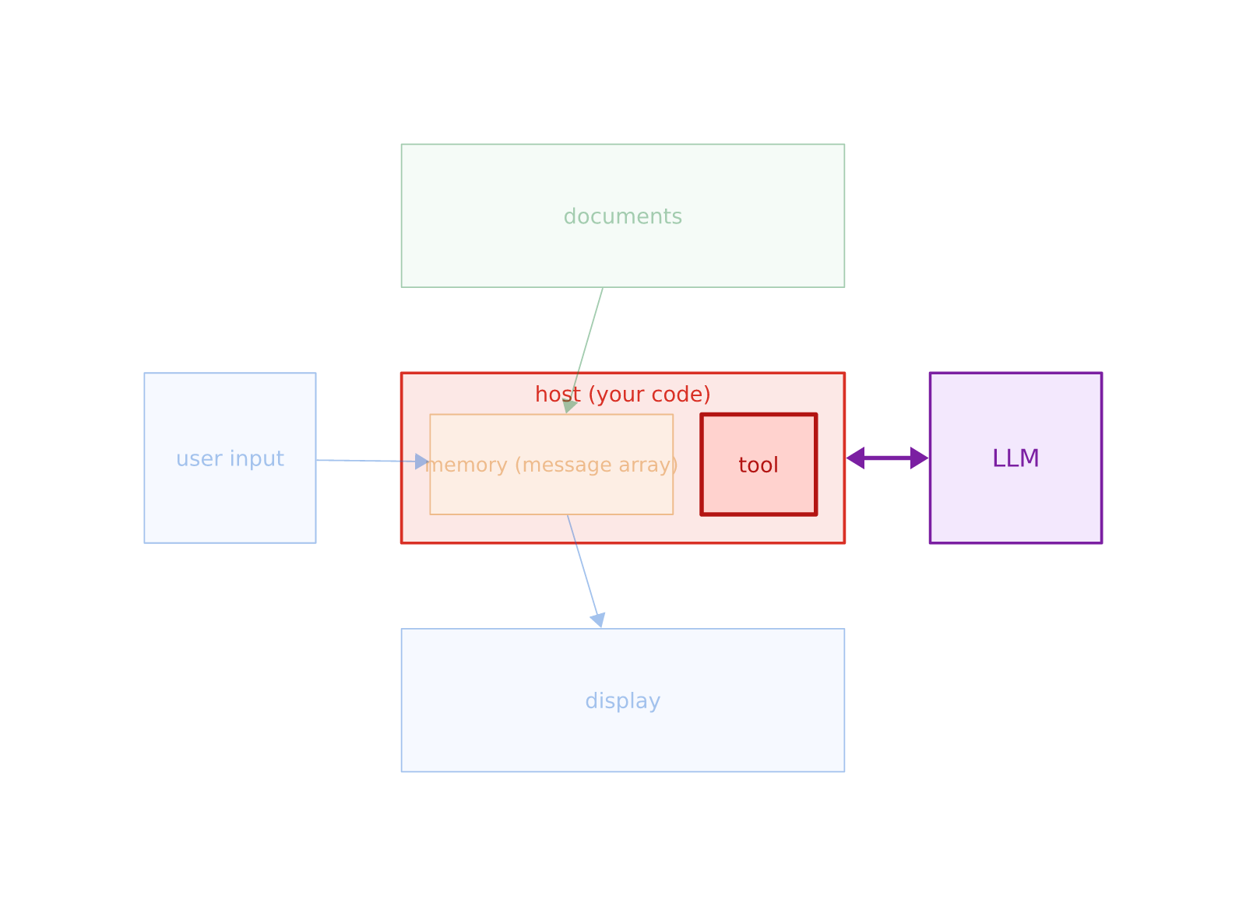
The First-Class Tool Contract
• First-Class Tool API: Declare available functions with explicit JSON schemas in the API request.
• Separate Channels: The model emits structured tool invocation blocks separate from message text.
• The Host Decides: The model proposes tool calls; the host validates and executes them.
22 / 43

Slide 23
Declaring Tool Schemas
• Tool Name & Description: Plain English explanations guide the model on when to select the tool.
• Input Schema (JSON Schema): Defines exact required parameters, types, and constraints.
• Type Safety: Enables compile-time and runtime validation before executing local methods.
// Tool Schema Declaration (C# Bedrock)
var tool = new Tool
{
ToolSpec = new ToolSpecification
{
Name = "read_file",
Description = "Read content of a source file",
InputSchema = new ToolInputSchema
{
Json = Document.FromObject(new
{
type = "object",
properties = new
{
path = new { type = "string" },
offset = new { type = "integer" }
},
required = new[] { "path" }
})
}
}
};
23 / 43

Slide 24
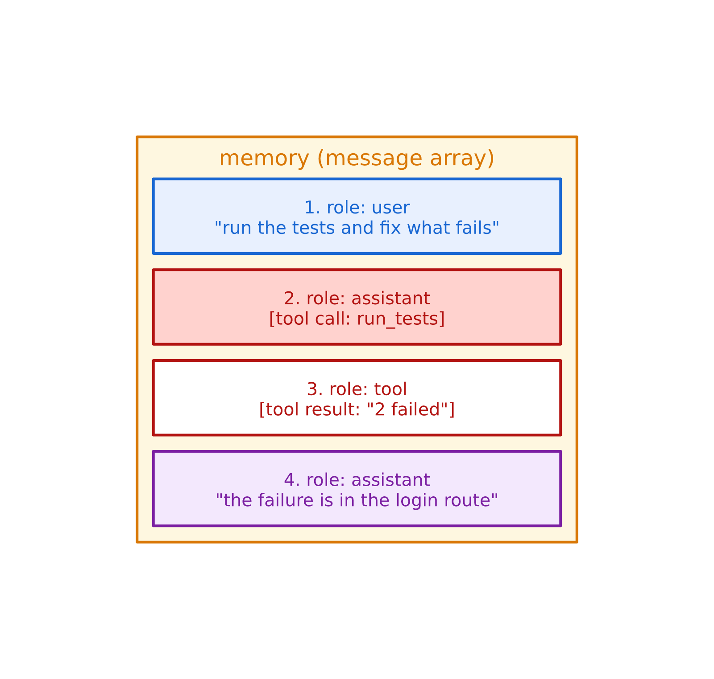
The Second Heartbeat
• Turn 1 (Model): Returns `tool_use` content block with target tool name and arguments.
• Turn 2 (Host): Executes local function (e.g., database query or file read).
• Turn 3 (Result): Appends `tool_result` content block to history array and calls model again.
• Running Errands: A single user prompt may trigger a dozen internal tool roundtrips.
24 / 43

Slide 25
Validate Before Acting
• Never Trust Model Arguments: Validate paths, types, permissions, and ranges in host code.
• Graceful Feedback: Return tool failure messages as content blocks so the model can adapt.
• Security Boundary: Your host code enforces access control; the model only holds a pencil.
// Model Requests Unauthorized Path:
{
"name": "read_file",
"input": { "path": "../../etc/shadow" }
}
// Host Defensively Validates:
if (!IsWithinProjectRoot(path))
{
return new ToolResultContentBlock {
Status = ToolResultStatus.Error,
Content = new() { new() {
Text = "Access denied: path outside sandbox."
} }
};
}
Defensive Boundary: Host intercepts path traversal, rejects safely, and sends error block so model can re-aim.
25 / 43

Slide 26
SECTION 5
The Toolbox
Read Tools, the Surgical Write, and the Shell
26 / 43

Slide 27
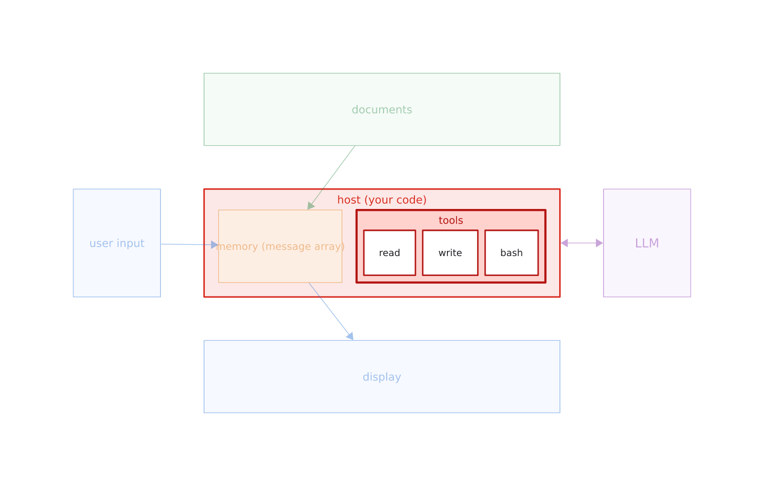
The Developer Bench
• Toolbox Fans Out: The single tool interface expands into specialized file system tools.
• Tools Define Character: A read tool makes a researcher; a write tool makes an editor; a shell makes an operator.
• Standardized Foundation: Every tool uses the exact same `tool_use` -> `tool_result` protocol.
27 / 43

Slide 28
Read Tools: Exploring Codebases
• Eyes for the Machine: `list_files` answers 'what is here'; `read_file` inspects contents.
• Read Selectively: Always support line offsets and limits to prevent massive file dumps.
• Context Discipline: Reading whole files needlessly floods the history array.
// 1. List files in directory
tool_call: list_files(path: "src/auth/")
// Result: ["login.py", "tokens.py", "models.py"]
// 2. Read specific slice with offset & limit
tool_call: read_file(
path: "src/auth/login.py",
offset: 35,
limit: 20
)
// Result: lines 35-55 only (not the whole 500-line file)
28 / 43

Slide 29
The Surgical Write Idiom
• The Surgical Pair: `oldstring` specifies the exact target lines; `newstring` replaces them.
• Cost Proportional to Diff: Editing one line in a 1,000-line file costs only two lines of tokens.
• Clear Human Review: Produces clean, readable diffs rather than full-file replacements.
• Preventing Corruption: Avoids rewriting untouched code where generation errors could hide.
// The Surgical Write Request
{
"tool": "edit_file",
"file": "src/auth/login.py",
"oldstring": "if (attempts > 5) LockAccount();",
"newstring": "if (attempts > 3) LockAccount();"
}
// Benefit 1: Token cost proportional to diff (2 lines)
// Benefit 2: Reviewable 1-line diff in pull requests
// Benefit 3: Zero chance of corrupting untouched methods
29 / 43

Slide 30
Safety Lock: Oldstring Validation
• Proof of Context: Requiring `oldstring` forces the model to prove what is currently in the file.
• Ambiguity Protection: If `oldstring` matches zero or multiple locations, the tool aborts safely.
• Self-Correction: The error feedback loop lets the agent re-read the target file and retry.
// Concurrency / Miss Case:
// File was modified by human developer after model read it:
"oldstring": "if (attempts > 5) LockAccount();"
// Tool Execution in Host:
if (!fileContent.Contains(oldstring))
{
return "Error: oldstring not found. File may have changed.";
}
if (CountMatches(fileContent, oldstring) > 1)
{
return "Error: oldstring matches multiple locations. Provide more context.";
}
The Failure Is the Feature: Refusal to apply mismatched edits protects codebase integrity against stale reads.
30 / 43

Slide 31
The Shell: 50 Years of Unix
• One Interface, Infinite Utility: A single `bash(command)` tool provides search, build, and test.
• Rapid Discovery: `grep` and `find` locate relevant files in milliseconds across large repos.
• Automated Verification: Running unit tests gives the agent objective, executable feedback.
// 1. Search across repository in one turn:
$ grep -rn "LockAccount" src/
src/auth/login.py:42: if (attempts > 5) LockAccount();
// 2. Perform surgical edit...
// 3. Verify fix by executing test runner:
$ dotnet test --filter FullyQualifiedName~LoginTests
Passed! - Failed: 0, Passed: 14, Total: 14
31 / 43

Slide 32
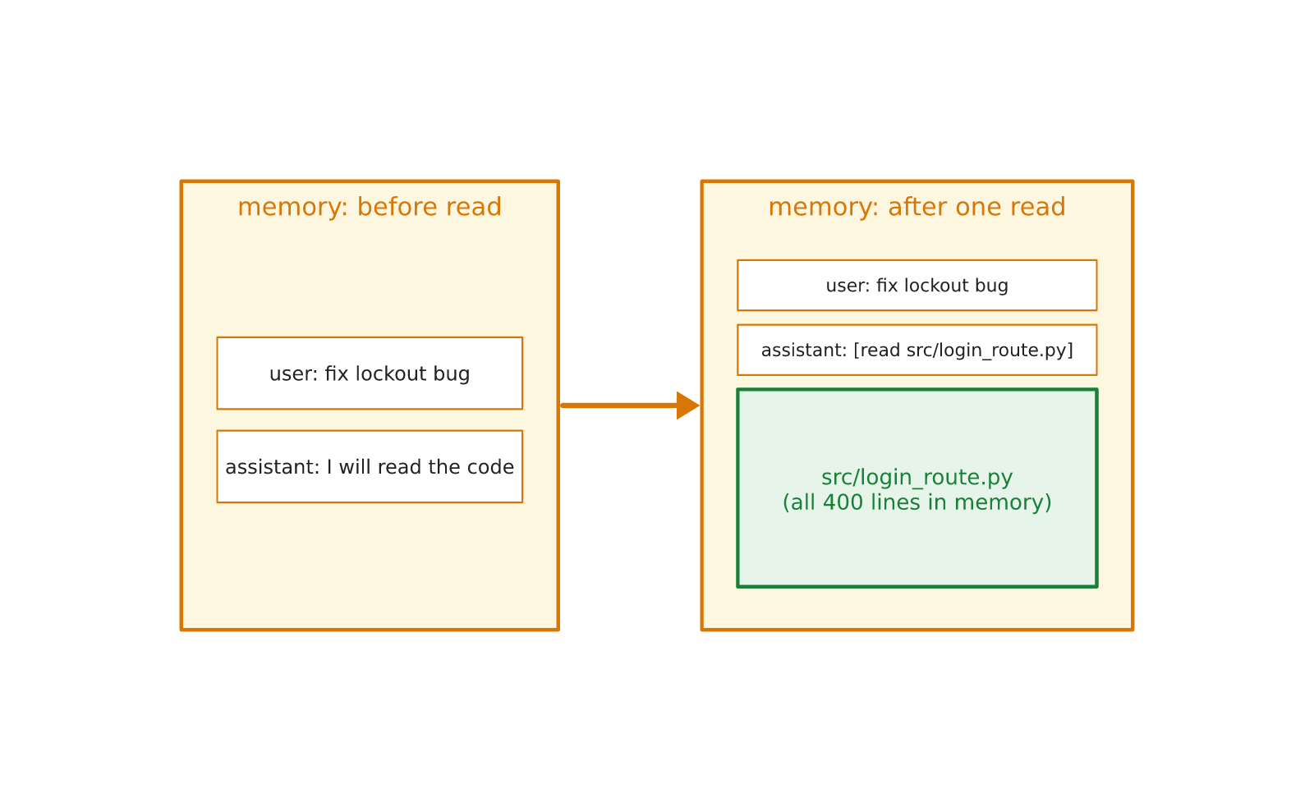
The River: Flood & Permissions
• The River of Tool Outputs: Every file read, grep output, and test log accumulates in the array.
• Security & Approvals: Shell access requires strict sandboxing and human-in-the-loop approvals.
• The Impending Limit: Complex tasks quickly generate tens of thousands of tokens of history.
32 / 43

Slide 33
SECTION 6
Memory Management
Compaction, Sessions, and the Machine Assembled
33 / 43

Slide 34
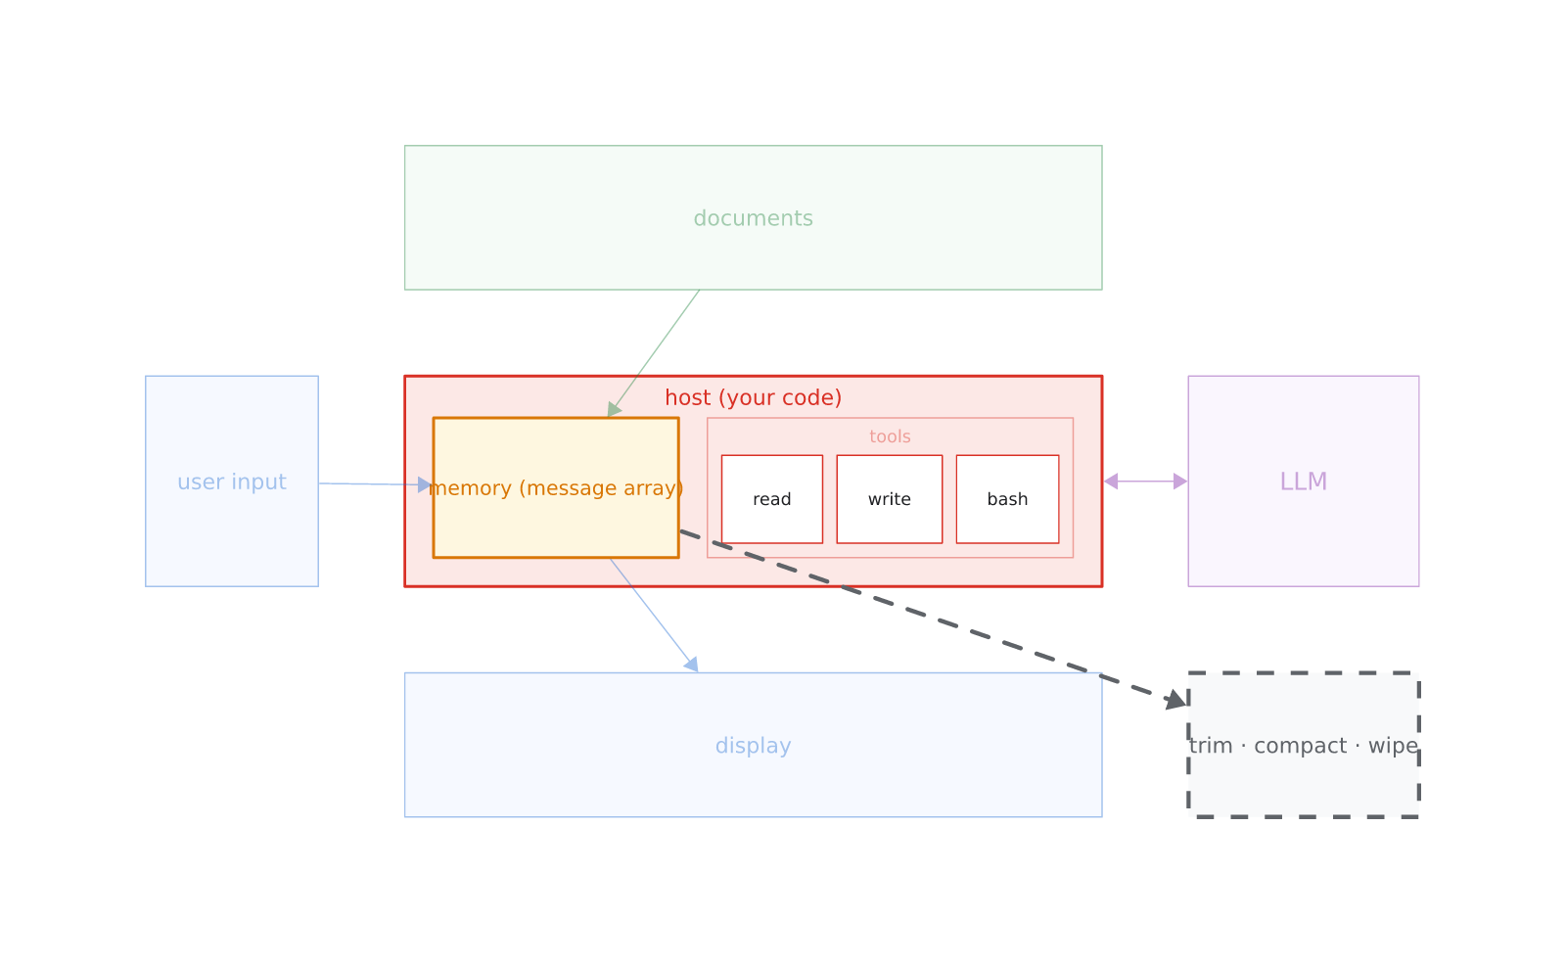
Active Memory Management
• The Host Must Subtract: The loop naturally appends; the host must actively trim and clean.
• Three Primary Operations:
◦ Trim: Drop oldest non-system turns from the head of the array.
◦ Compact: Summarize earlier dialogue into a concise handoff block.
◦ Wipe: Discard the current array and start a fresh session.
34 / 43

Slide 35
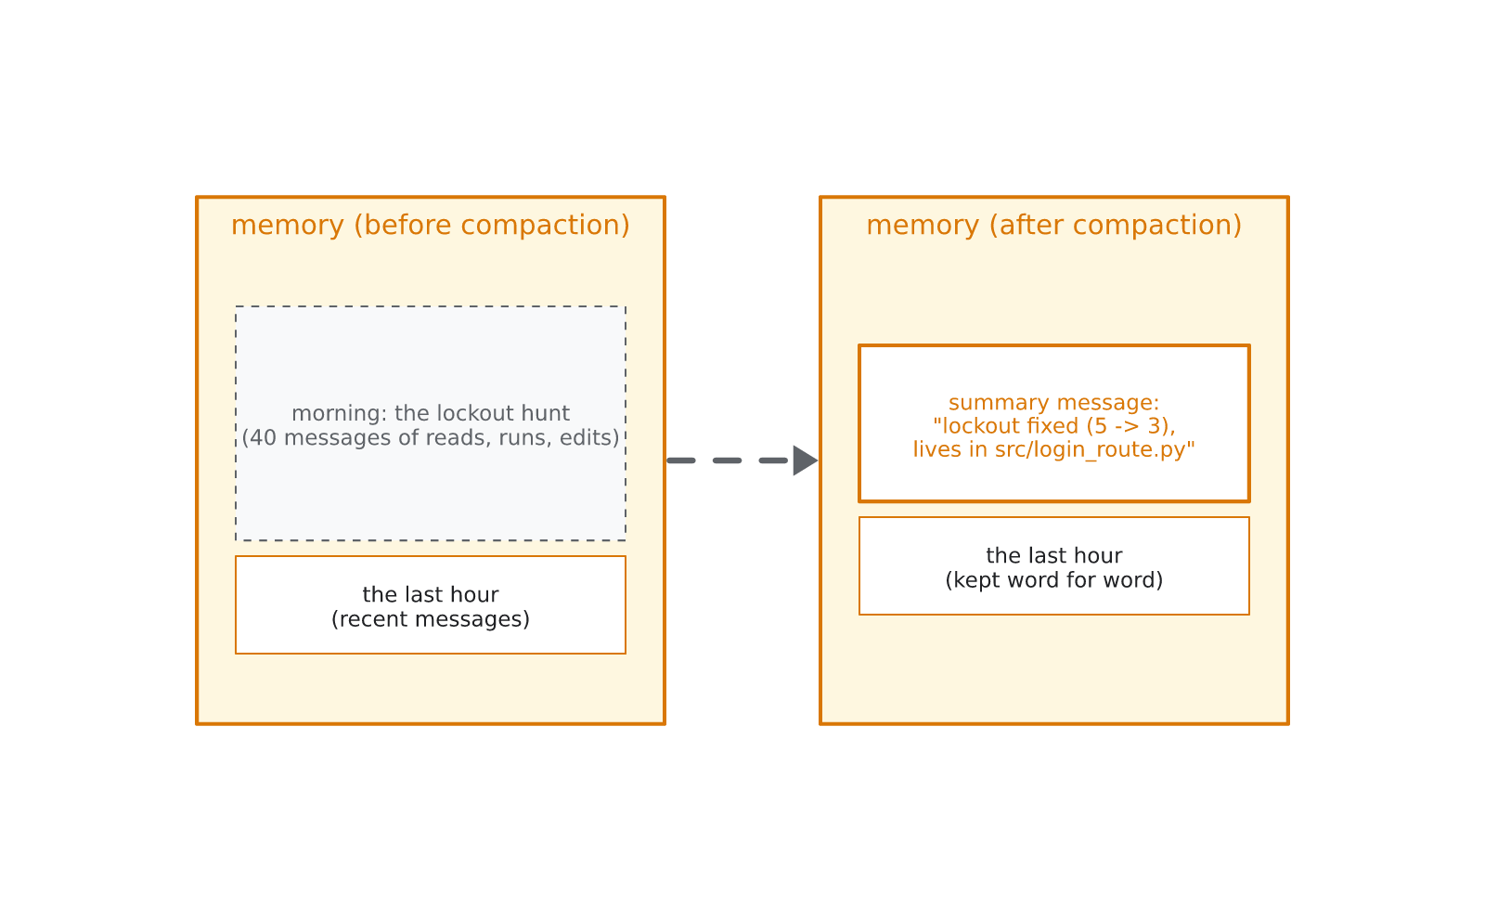
Compaction in Practice
• Summarize & Replace: 40 turns of exploratory tool calls compress into a single summary block.
• Focus on Handoff State: Record decisions made, modified file paths, and pending tasks.
• Preserve Recent Turns: Retain the latest user and assistant turns for immediate continuity.
• Controlled Information Loss: Compaction drops noise while preserving critical working state.
35 / 43

Slide 36
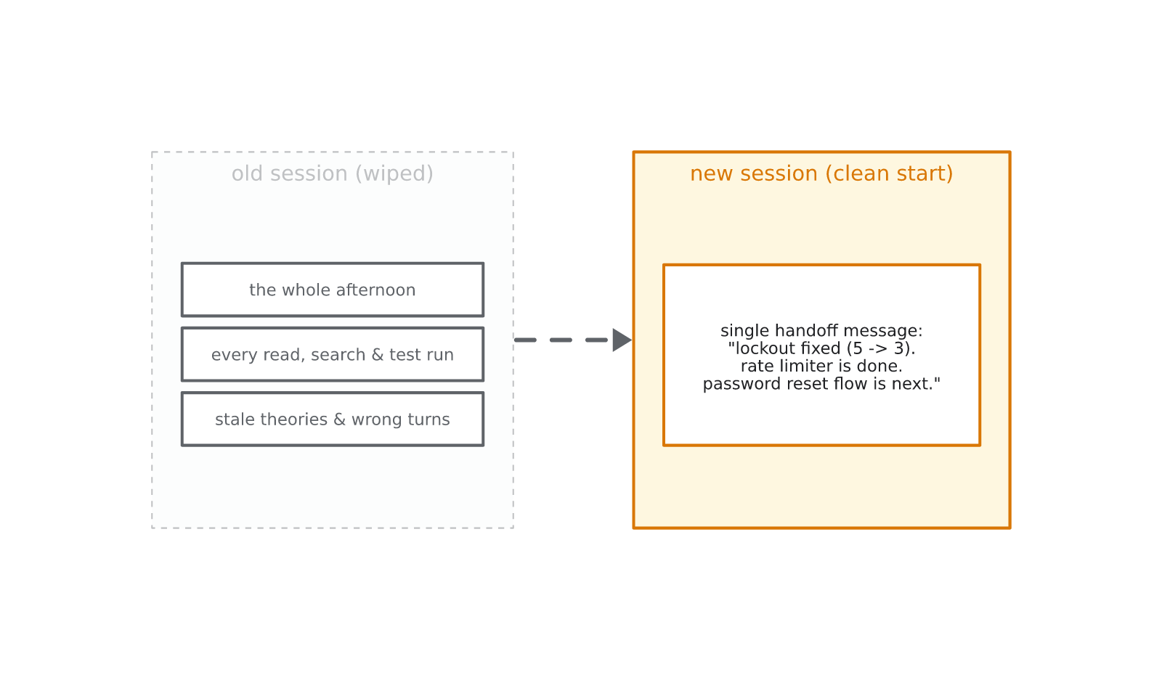
Sessions: The Power of the Wipe
• Wipe as a Feature: Clearing memory prevents toxic context or mistaken theories from persisting.
• Clean Handoffs: Start new sessions with an explicit summary prompt describing the current baseline.
• Reproducible Testing: Isolated sessions allow deterministic testing and eval replay.
36 / 43

Slide 37
The Machine, Assembled
• Deconstructing Modern Agents: Tools like Cursor, Claude Code, and Copilot are this exact architecture.
• Every Box Is Code: Loop (Ch 2), Knowledge (Ch 3), Tools (Ch 4), Toolbox (Ch 5), Memory (Ch 6).
• No Magic: An agent is a stateless HTTP call, an array, JSON schemas, and a loop.
37 / 43

Slide 38
SECTION 7
Recap & Knowledge Check
Summary, Review Questions, and Next Steps
38 / 43

Slide 39
Key Takeaways & What Is Next
• Stateless Core: The model has no persistent memory; the host manages all context.
• Structured Tool Contract: Never scrape text; declare schemas and handle tool blocks.
• Memory as a Budget: Proactively trim and compact history before hitting token limits.
• Session 3 Preview: Extending the agent harness into autonomous coding and test repair.
// The Complete Agent Harness Architecture
while (taskPending)
{
// 1. Compact memory if token budget > 80%
if (GetTokenCount(memory) > Threshold)
memory = await CompactHistory(memory);
// 2. Call model with tools & memory
var response = await CallLLM(memory, tools);
// 3. Dispatch tool calls or display final reply
if (response.HasToolUse)
await DispatchToolsAndAppend(memory, response);
else
Display(response.Text);
}
39 / 43

Slide 40
Check Your Understanding
1. What component in an agent architecture owns and stores the message array?
2. How do multi-modal inputs (images, attachments) and tool results enter a message?
3. Why should you treat streamed LLM outputs as unverified until completion?
4. What is the fundamental problem with the naive 'append-only' loop?
5. What is the operational difference between RAG and whole-document attachment?
6. Why is the 'oldstring / newstring' surgical write pattern superior to whole-file replacement?
7. How does the 'oldstring' parameter serve as a safety lock during file edits?
8. What are the three primary operations used by the host to manage memory growth?
40 / 43

Slide 41
Check Your Understanding: Answer Key (1–4)
1. What component in an agent architecture owns and stores the message array?
➜ The Host (your application code). The LLM is a stateless HTTP engine that retains no memory.
2. How do multi-modal inputs (images, attachments) and tool results enter a message?
➜ As Content Blocks inside the message's content array (typed as text, image, or tool_result).
3. Why should you treat streamed LLM outputs as unverified until completion?
➜ Partial output is incomplete. Acting on half-streamed JSON causes parsing and runtime failures.
4. What is the fundamental problem with the naive 'append-only' loop?
➜ Token Explosion. Re-sending growing arrays multiplies costs, latency, and exhausts context windows.
41 / 43

Slide 42
Check Your Understanding: Answer Key (5–8)
5. What is the operational difference between RAG and whole-document attachment?
➜ RAG retrieves only relevant candidate passages, whereas attachments inject the entire file whole.
6. Why is the 'oldstring / newstring' surgical write pattern superior to whole-file replacement?
➜ Token efficiency (costs proportional to diff), clear reviewable diffs, and zero risk to untouched code.
7. How does the 'oldstring' parameter serve as a safety lock during file edits?
➜ It verifies target file contents before replacing; mismatched or ambiguous targets fail safely.
8. What are the three primary operations used by the host to manage memory growth?
➜ Trim (drop oldest turns), Compact (summarize past turns into a handoff block), and Wipe (reset session).
42 / 43

Slide 43
Thank You
Questions? Comments? Concerns?
Monarch Wadia · monarchwadia.com

