Slide 1
Large Language Models
for Software Engineers
Session 1: Understanding the Model & The Single Call
Monarch Wadia · monarchwadia.com

Slide 2
SECTION 1
Logistics & Goals
Course Structure and Learning Outcomes
2 / 37

Slide 3

Series Logistics & Structure
• Course Format: Three one-hour technical sessions with hands-on coding exercises.
• Session Progression:
◦ Session 1 (Today): The Single Call & Foundational Concepts.
◦ Session 2: Multi-Turn Chatbots & State Management.
◦ Session 3: Tool Calling & Autonomous Agent Loops.
• Prerequisites: Backend engineering experience and .NET / local development SDK.
• AWS Bedrock Access: Region `ca-central-1` (Canada Central) with temporary workshop keys.
3 / 37

Slide 4

Workshop Series Learning Outcomes
• 1. Treat LLMs as Infrastructure: View models as stateless HTTP microservices.
• 2. Build from First Principles: Connect the Model, the Harness, and Tools.
• 3. Control Developer Agent Tools: Diagnose and optimize coding tools (Cursor, Claude Code) through prompt and context mechanics.
• 4. Prevent Production Failures: Design defenses against hallucinations, format drift, and token limits.
4 / 37

Slide 5

Session 1 Learning Outcomes
• 1. Master the Single Call: Send structured HTTP requests and parse metadata.
• 2. Manage Memory in Code: Store conversation state in application memory arrays.
• 3. Apply Single-Call Tasks: Transform, classify, extract, summarize, evaluate, and expand data.
• 4. Separate Control Planes: Author modular system prompts with explicit contracts.
• 5. Handle Failure Modes: Prevent hallucinations, format drift, truncation, and variance.
5 / 37

Slide 6
SECTION 2
The Model & The Single Call
Core Architecture, Primitives, and Production Gotchas
6 / 37

Slide 7

The Engineering Mental Model
• Standard Infrastructure: An LLM is a standard backend component. Treat it like a database, cache, or web service.
• Deterministic Integration: Your application code controls data flow, authorization, and error handling.
• Multiple Architecture Patterns: Agents are only one architecture pattern. LLMs also classify, extract, and convert data.
• Existing Skills Apply: Standard software engineering principles ensure reliability, security, and performance.
7 / 37

Slide 8
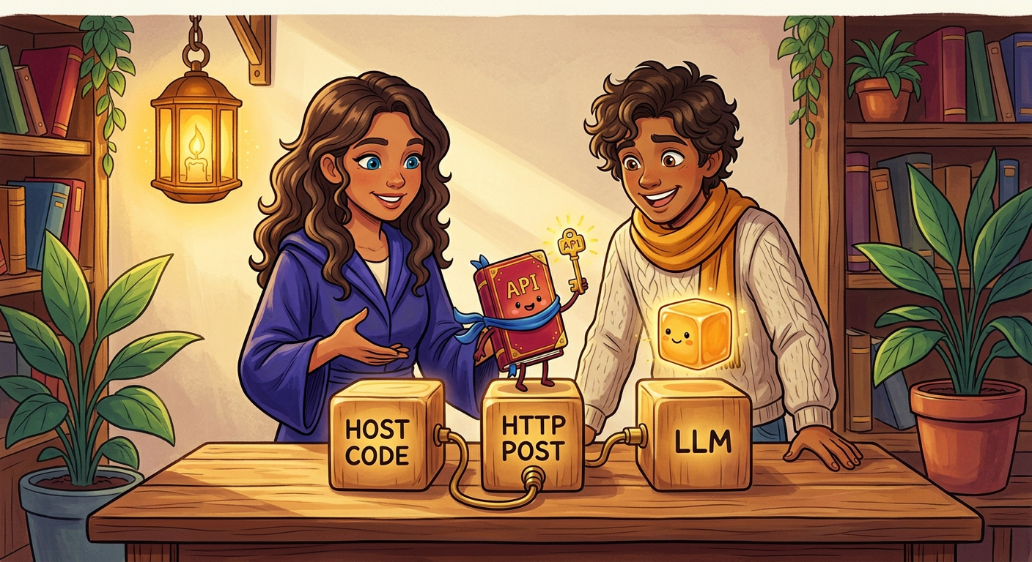
The Three System Components
• Standard System Terminology: You do not need data science training. Use standard software engineering concepts.
• The Three Core Components:
◦ The Model: A remote HTTP service that predicts next tokens.
◦ The Harness: Your application code that manages state, flow, and logic.
◦ Tools: Integrations that connect the model to databases and APIs.
• Clear Separation of Concerns: Keep business logic in the harness, not in model weights.
8 / 37

Slide 9

The Agent Loop
• Four-Step Execution Loop: An agent is software that runs a four-step loop:
◦ 1. Send Request: Send the prompt and history array over HTTP.
◦ 2. Receive Output: Read generated text and tool requests from the response.
◦ 3. Execute Tools: Run local database queries or API calls.
◦ 4. Update History: Append inputs, outputs, and tool results to the history array.
• The Single Call Foundation: Start with single API calls before you build loops.
9 / 37

Slide 10
The HTTP Request Payload
• HTTP POST Interface: The application sends a JSON payload containing an array of messages.
• Three Message Roles:
◦ system: Defines instructions, security rules, and output schemas.
◦ user: Contains input from clients or external systems.
◦ assistant: Contains past responses from the model.
• Inference Parameters:
◦ temperature: Controls randomness (use 0.0 for deterministic tasks).
◦ max_tokens: Sets the maximum token count for the response.
{
"model": "anthropic.claude-3-5-sonnet",
"messages": [
{
"role": "system",
"content": "You are a banking assistant."
},
{
"role": "user",
"content": "What is my TFSA balance?"
}
],
"temperature": 0.1,
"max_tokens": 500
}
10 / 37

Slide 11
Response Payload Structure
• Structured JSON Response: The API returns metadata and a list of content blocks.
• Content Block: The response text is stored in the `content` array with `role: 'assistant'`.
• Stop Reasons:
◦ end_turn: The model completed the response normally.
◦ max_tokens: Generation stopped because output reached the token limit.
• Usage Metrics: Tracks input and output token counts for cost accounting.
{
"id": "msg_01XYZ...",
"type": "message",
"role": "assistant",
"content": [
{
"type": "text",
"text": "Your TFSA balance is $32,450 CAD."
}
],
"stop_reason": "end_turn",
"usage": {
"input_tokens": 128,
"output_tokens": 22
}
}
11 / 37

Slide 12
The Conversation History Array
• State in Application Memory: Store the conversation history array in your application RAM or database.
• Array Mutation Flow:
◦ Turn 1: Send the user message. Append the assistant response to the array.
◦ Turn 2: Append the new user message. Send the full array to the API.
• Stateless Context: The model interprets new messages only because the request includes past turns.
// Turn 1: user sends request
"messages": [
{ "role": "user",
"content": "What is my TFSA balance?" }
]
// After Turn 1: code appends response
"messages": [
{ "role": "user",
"content": "What is my TFSA balance?" },
{ "role": "assistant",
"content": "$32,450.22 CAD." }
]
// Turn 2: resend FULL history array
"messages": [
{ "role": "user",
"content": "What is my TFSA balance?" },
{ "role": "assistant",
"content": "$32,450.22 CAD." },
{ "role": "user",
"content": "And my RRSP balance?" }
]
12 / 37

Slide 13
Tool Execution Overview
• No Direct Database Access: The remote model cannot read your database directly.
• Execution Sequence:
◦ 1. Declare Tool Schema: Define function names and parameter schemas in JSON.
◦ 2. Model Emits Request: The model returns a tool call request with parameters.
◦ 3. Application Runs Query: Your code executes the local database query.
◦ 4. Return Result: Append the tool result to the history array and call the model again.
• Full Control: Your application code executes all database queries.
{
"tools": [
{
"name": "get_account_balance",
"description": "Fetch live CAD balance.",
"input_schema": {
"type": "object",
"properties": {
"account_type": {
"type": "string",
"enum": ["TFSA", "RRSP"]
}
},
"required": ["account_type"]
}
}
]
}
13 / 37

Slide 14
Hands-On: Your First API Call
• Local Environment Verification: Send an authenticated API request to AWS Bedrock using C#.
• Step 1: Extract `workshop-1-code.zip` to a local folder.
• Step 2: Add your AWS credentials to the `.env` file.
• Step 3: Run `dotnet run` in the terminal to execute the test call.
• Step 4: Change the prompt text in `Program.cs` and test custom inputs.
// dotnet run
using Amazon.BedrockRuntime;
using Amazon.BedrockRuntime.Model;
var client = new AmazonBedrockRuntimeClient();
var request = new ConverseRequest
{
ModelId = "anthropic.claude-3-5-sonnet",
Messages = new List<Message>
{
new Message
{
Role = ConversationRole.User,
Content = new List<ContentBlock>
{
new ContentBlock { Text = "Ping" }
}
}
},
InferenceConfig = new InferenceConfiguration
{
MaxTokens = 100,
Temperature = 0.0f
}
};
var response = await client.ConverseAsync(request);
Console.WriteLine(response.Output.Message.Content[0].Text);
14 / 37

Slide 15

What Can a Single Call Do?
• No Agent Loop Required: Solve common backend tasks with a single stateless request.
• Replaces Custom ML Pipelines: Use prompts instead of collecting training data and hosting custom models.
• Six Common Tasks:
◦ Transform: Convert data representations and schemas.
◦ Classify: Assign text to predefined categories.
◦ Extract: Parse structured JSON from unstructured text.
◦ Summarize: Condense documents while preserving key facts.
◦ Evaluate: Validate data against compliance rules (LLM-as-a-judge).
◦ Expand: Generate complete letters or reports from short notes.
15 / 37

Slide 16
Single Call Task: Transform
• Function: Converts input data from one format or syntax to another.
• Common Software Use Cases:
◦ Convert natural language text into SQL or GraphQL queries.
◦ Translate technical error messages into client-facing text.
◦ Convert legacy data structures to modern API schemas.
• Primary Benefit: Requires no custom parsing grammar and handles ambiguous inputs.
// Request:
{
"system": "Translate English to SQL.\n" +
"Schema: trades(id, ticker, qty, cad_val)",
"messages": [{
"role": "user",
"content": "Find trades > $100k CAD for XIU"
}]
}
// LLM Output:
SELECT id, ticker, qty, cad_val
FROM trades
WHERE ticker = 'XIU'
AND cad_val > 100000;
16 / 37

Slide 17
Single Call Task: Classify
• Function: Maps unstructured text into a fixed set of category labels.
• Common Software Use Cases:
◦ Route customer support tickets to the correct department.
◦ Classify financial transactions for accounting and tax rules.
◦ Detect urgent compliance escalations and customer sentiment.
• Primary Benefit: Add or modify categories in the prompt without model retraining.
// Request:
{
"system": "Classify message into category:\n" +
"[TRADE_DISPUTE, TAX_INQUIRY, WIRE_TRANSFER]\n" +
"Return JSON: {category, confidence}",
"messages": [{
"role": "user",
"content": "Why was my $15k wire delayed?"
}]
}
// LLM Output:
{
"category": "WIRE_TRANSFER",
"confidence": 0.98
}
17 / 37

Slide 18
Single Call Task: Extract
• Function: Extracts strongly typed fields from unstructured text into JSON.
• Common Software Use Cases:
◦ Extract transaction amounts, dates, and account numbers from invoices.
◦ Parse trade instructions and quantities from incoming emails.
◦ Extract structured entity records from regulatory filing documents.
• Primary Benefit: Handles spelling errors, abbreviations, and format variations.
// Request:
{
"system": "Extract trade orders to JSON:\n" +
"[{ticker, action, qty}]",
"messages": [{
"role": "user",
"content": "Buy 500 XIU and sell 200 VCN\n" +
"for my RRSP."
}]
}
// LLM Output:
[
{ "ticker": "XIU", "action": "BUY", "qty": 500 },
{ "ticker": "VCN", "action": "SELL", "qty": 200 }
]
18 / 37

Slide 19
Single Call Task: Summarize
• Function: Condenses long documents while retaining critical numbers and decisions.
• Common Software Use Cases:
◦ Generate daily executive summaries of market news.
◦ Condense advisor call notes into CRM activity records.
◦ Create concise digests of financial prospectus filings.
• Primary Benefit: Enforces length constraints and preserves specific numerical facts.
// Request:
{
"system": "Summarize policy in 1 bullet.\n" +
"Keep key policy rates.",
"messages": [{
"role": "user",
"content": "Bank of Canada cut policy rate\n" +
"by 25 bps to 3.75%, citing core\n" +
"inflation cooling to 2.3%."
}]
}
// LLM Output:
- Bank of Canada cut rate by 25 bps
to 3.75% as inflation cooled to 2.3%.
19 / 37

Slide 20
Single Call Task: Evaluate
• Function: Scores input text against explicit policy rules and constraints.
• Common Software Use Cases:
◦ Validate transactions against anti-money laundering (AML) thresholds.
◦ Check drafted advisor messages for compliance violations.
◦ Run automated test assertions on software outputs (LLM-as-a-judge).
• Primary Benefit: Returns a boolean pass/fail status and an explanation.
// Request:
{
"system": "Evaluate against FINTRAC AML rules.\n" +
"Flag if cash >= $10k CAD.\n" +
"Return JSON: {flagged: bool, reason: str}",
"messages": [{
"role": "user",
"content": "Client deposited $12,500 cash."
}]
}
// LLM Output:
{
"flagged": true,
"reason": "Deposit of $12,500 CAD exceeds\n" +
"the $10,000 FINTRAC reporting threshold."
}
20 / 37

Slide 21
Single Call Task: Expand
• Function: Generates complete, natural text from concise bullet points or data records.
• Common Software Use Cases:
◦ Draft client portfolio review letters from performance metrics.
◦ Generate release notes from git commit logs and pull requests.
◦ Draft initial customer service responses for human review.
• Primary Benefit: Converts raw metrics into clear human communication.
// Request:
{
"system": "Wealth advisor persona.\n" +
"Expand notes to client letter.\n" +
"Tone: professional, concise.",
"messages": [{
"role": "user",
"content": "Dr. Thorne: Shifted $50k\n" +
"from US Eq to CAD Bonds."
}]
}
// LLM Output:
Dear Dr. Thorne,
We completed your portfolio
rebalancing today. We shifted
$50,000 from US Equities into
Canadian Bonds to reduce
volatility and lock in yields.
Best regards,
Wealth Advisory Team
21 / 37

Slide 22
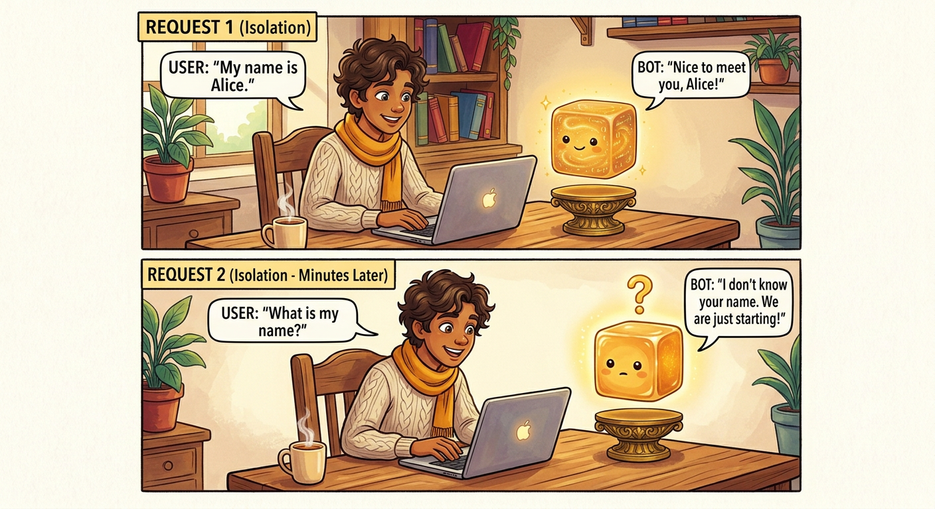
The Core Rule: LLMs Are Stateless
• Zero Internal Memory: The model retains no data between API requests: `f(messages) -> message`.
• Architectural Benefits of Statelessness:
◦ Fault Tolerance: Retry failed requests without corrupting remote state.
◦ Auditability: Maintain an exact record of all inputs and outputs.
◦ Dynamic Context: Add or remove messages on any request.
◦ Branching and Replay: Fork conversation threads and replay logs for automated tests.
22 / 37

Slide 23

System Prompts: The Control Plane
• Separation of Planes: Separate control instructions from untrusted data.
• Control Plane (`system`): Developers define rules, guardrails, and output schemas.
• Data Plane (`user`): Contains untrusted input from external users, emails, and webhooks.
• Instruction Hierarchy: Frontier models prioritize system rules over user input.
23 / 37

Slide 24
Structuring System Prompts: A Standard Pattern
• Modular Prompt Design: Divide system prompts into discrete, testable sections.
• Four Common Sections:
◦ 1. Persona: Sets the role, tone, and operational perspective.
◦ 2. Runtime Context: Injects environment variables, dates, and jurisdictions.
◦ 3. Guardrails: Defines explicit negative constraints and forbidden actions.
◦ 4. Output Contract: Specifies the exact JSON schema and required fields.
• Extensible Architecture: Adapt the structure to match system complexity.
payload = {
"system": ""
# 1. Persona
Senior Compliance Officer.
# 2. Runtime Context
Jurisdiction: FINTRAC (Canada)
Date: 2026-08-20
# 3. Guardrails
- Flag cash deposits >= $10k CAD.
- Never provide tax advice.
# 4. Output Contract
Return JSON: {flagged: bool, reason: str}
"",
"messages": [
{"role": "user", "content": "Deposited $12k cash."}
]
}
24 / 37

Slide 25
System Prompts vs. Few-Shot Examples
• Instruction by Rule (System): Sets global constraints, policies, and valid enums.
• Instruction by Example (Few-Shot): Injects sample message turns into the history array.
• Combined Strategy: Use few-shot examples to clarify edge cases that rules describe poorly.
• Runtime Configuration: Guide model behavior at runtime without model fine-tuning.
payload = {
"system": ""
Classify tickers into asset class:
[EQUITY, FIXED_INCOME, CRYPTO]
Return JSON: {ticker: str, class: str}
"",
"messages": [
# Few-Shot 1: Demonstrates output schema
{"role": "user", "content": "XIU.TO"},
{"role": "assistant", "content":
'{"ticker": "XIU.TO", "class": "EQUITY"}'},
# Few-Shot 2: Edge-case demonstration
{"role": "user", "content": "XBB.TO"},
{"role": "assistant", "content":
'{"ticker": "XBB.TO", "class": "FIXED_INCOME"}'},
# Actual User Request
{"role": "user", "content": "BTC-CAD"}
]
}
25 / 37

Slide 26

Context Windows: The Working RAM
• Fixed Token Capacity: The context window defines the maximum token budget for a single API call.
• Shared Budget: `Total Capacity = Input Tokens + Output Buffer`. Longer inputs reduce available output length.
• Performance Impact: Larger input prompts increase processing latency (TTFT) and API cost.
26 / 37

Slide 27
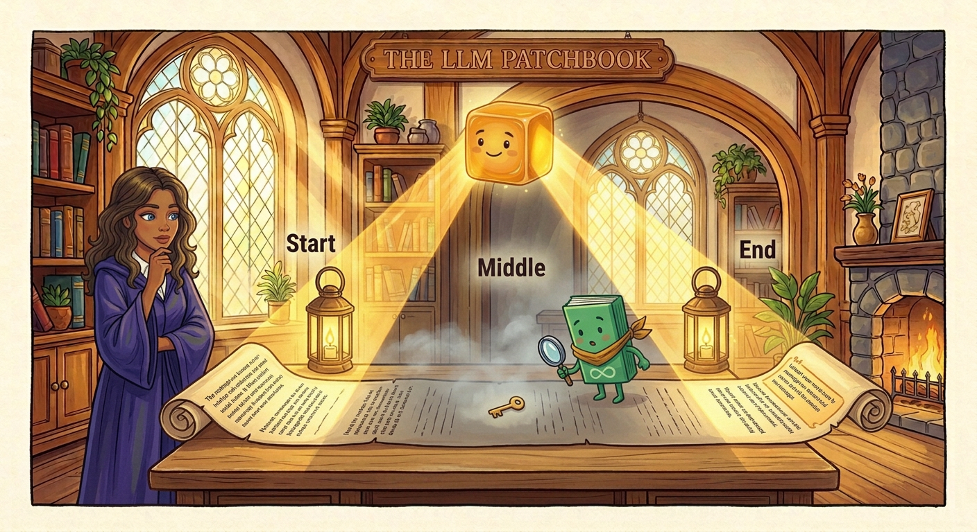
The 'Lost in the Middle' Effect
• Non-Uniform Attention: Models process tokens at different positions with varying attention weights.
• The U-Shaped Attention Curve: Recall accuracy is highest at the start and end of the prompt.
• Placement Strategy: Place critical instructions in the system prompt (top) or task prompt (bottom).
27 / 37

Slide 28
Gotcha 1: Hallucinations
• Failure Mode: The model generates plausible but incorrect facts with high confidence.
• Root Cause: Models predict likely token sequences. They do not query external facts automatically.
• Prevention Methods:
◦ Add explicit rule: *'If facts are not in context, state that data is unavailable.'*
◦ Inject verified reference documents (RAG) or query tools before generating factual answers.
// Request without source documents:
{
"messages": [{
"role": "user",
"content": "What was our Q3 dividend yield?"
}]
}
// LLM Output:
{
"dividend_yield": "4.85%",
"payout_date": "2026-10-15",
"source": "Q3 Financial Summary"
}
Error: Hallucination. The model generated plausible values without reference data in the prompt.
28 / 37

Slide 29
Gotcha 2: Format Drift
• Failure Mode: The model encloses JSON in markdown fences (` ```json `) or adds conversational text.
• Impact: Application JSON parsers fail with parsing exceptions.
• Prevention Methods:
◦ Add explicit rule: *'Output raw JSON only. Do not use markdown fences.'*
◦ Sanitize and strip markdown code fences in application code before parsing.
// Request:
{
"system": "Return raw JSON only: {id, status}",
"messages": [{
"role": "user",
"content": "Order #448-9102"
}]
}
// LLM Output:
```json
{
"id": "448-9102",
"status": "APPROVED"
}
```
Error: Format Drift. Output contains markdown code fences (```json). JSON parser failed.
29 / 37

Slide 30
Gotcha 3: Token Limit & Truncation
• Failure Mode: The model stops output generation in the middle of a sentence or JSON object.
• Root Cause: Generated output reached the configured `max_tokens` limit.
• Prevention Methods:
◦ Check `stop_reason` in the response payload (`end_turn` vs `max_tokens`).
◦ Set sufficient `max_tokens` limits for complex schema outputs.
// Request with low max_tokens limit:
{
"max_tokens": 30,
"messages": [{
"role": "user",
"content": "Audit transaction history."
}]
}
// LLM Output:
{
"audit_status": "COMPLIANT",
"flagged_items": [
{ "tx_id": "tx_9918", "note": Cash
Error: Truncation. Output reached max_tokens limit before completion. stop_reason = 'max_tokens'.
30 / 37

Slide 31
Gotcha 4: Non-Determinism
• Failure Mode: The same prompt produces different outputs on repeated API calls.
• Root Cause: Setting temperature to 0.0 minimizes randomness, but GPU cluster concurrency causes slight variance.
• Prevention Methods:
◦ Enforce strict JSON schemas and enum validation in the system prompt and few-shot examples.
◦ Validate and normalize model outputs in application code before execution.
// Request sent twice with temperature = 0.0:
{
"temperature": 0.0,
"system": "Classify client request.",
"messages": [{
"role": "user",
"content": "Reverse $45 USD wire fee."
}]
}
// Call 1: {"category": "WIRE_FEE_DISPUTE"}
// Call 2: {"category": "ACCOUNT_MAINTENANCE"}
Error: Non-Determinism. Concurrency across GPU nodes produced different category labels.
31 / 37

Slide 32
SECTION 3
Recap & Knowledge Check
Summary, Review Questions, and Next Steps
32 / 37

Slide 33

Key Takeaways & Next Steps
• Summary of Fundamentals:
◦ Pure Stateless Functions: Every call is independent: `f(messages) -> message`.
◦ Six Single-Call Tasks: Transform, Classify, Extract, Summarize, Evaluate, and Expand.
◦ Control Plane Architecture: System prompts enforce rules, tone, and JSON schema.
◦ Defensive Engineering: Guard against hallucinations, format drift, truncation, and variance.
• Application for Developer Tools:
◦ Explains context loss in long codebases (*Lost in the Middle*).
◦ Explains tool parsing failures caused by markdown leakage (*Format Drift*).
• Next Session: Build a multi-turn chatbot with stateful conversation memory.
33 / 37

Slide 34
Check Your Understanding
1. Where is conversation history stored in a multi-turn LLM application?
2. What is the mathematical representation of a stateless LLM API call?
3. Which message role sets instructions and schemas with highest priority?
4. What does the `max_tokens` stop reason indicate in an API response?
5. Does the remote model execute tool code directly in your database?
6. Which single-call task extracts structured JSON fields from messy emails?
7. What happens to recall accuracy in the middle of a large context window?
8. Why do markdown code fences (` ```json `) cause backend JSON parsing errors?
34 / 37

Slide 35
Check Your Understanding: Answer Key (1–4)
1. Where is conversation history stored in a multi-turn LLM application?
➜ In Application RAM (or database). The application appends turns and resends the complete array.
2. What is the mathematical representation of a stateless LLM API call?
➜ f(messages) -> message. The remote model retains zero internal memory between HTTP requests.
3. Which message role sets instructions and schemas with highest priority?
➜ The system role. Frontier models prioritize system instructions and guardrails over user input.
4. What does the max_tokens stop reason indicate in an API response?
➜ Token Truncation. Output generation stopped early because it reached the configured token limit.
35 / 37

Slide 36
Check Your Understanding: Answer Key (5–8)
5. Does the remote model execute tool code directly in your database?
➜ No. The model emits a tool call request; your application code executes the query and returns results.
6. Which single-call task extracts structured JSON fields from messy emails?
➜ Extract. It pulls strongly typed fields into JSON without brittle regular expressions.
7. What happens to recall accuracy in the middle of a large context window?
➜ Recall drops. Attention follows a U-shaped curve (the 'Lost in the Middle' effect).
8. Why do markdown code fences (```json) cause backend JSON parsing errors?
➜ Format Drift. Markdown code delimiters break strict JSON deserializers (System.Text.Json).
36 / 37

Slide 37
Thank You
Questions? Comments? Concerns?
Monarch Wadia · monarchwadia.com

